Slide 1


Implementing Low Code CQRS With Azure Logic Apps
Mandar Dharmadhikari
Business Integration Architecture Manager

Slide 2

Mandar Dharmadhikari
Business Integration Architecture Manager
Azure and Power Platform Architect
Continuous Delivery Enthusiast
Proud Pet Parent
codidharma@gmail.com
Mandar-dharmadhikari
@codidharma

Slide 3
Traditional CRUD based architecture and where it fails
What is CQRS?
Demos
Advantages/Disadvantages of CQRS

Slide 4
Traditional CRUD based architecture and where it fails

Slide 5
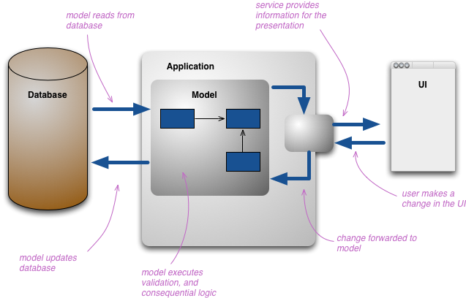
Traditional CRUD based Architecture
CRUD helps developers create a mental model to help understand how to interact with databases
Create, Read, Update, Delete closely resemble standard HTTP verbs like POST, PUT, GET
CRUD APIS serve best for 99% of the scenarios

Slide 6
Where CRUD might fall short
When Queries become complex and require multiple Database Joins(e.g. Insurance Quote Query)
Different Read-Write Scaling Requirement(e.g. Social Media Posts/Feed)
When Queries span multiple contexts and services(e.g. Across Order, Payment, Inventory Services)

Slide 7
What is CQRS?

Slide 8
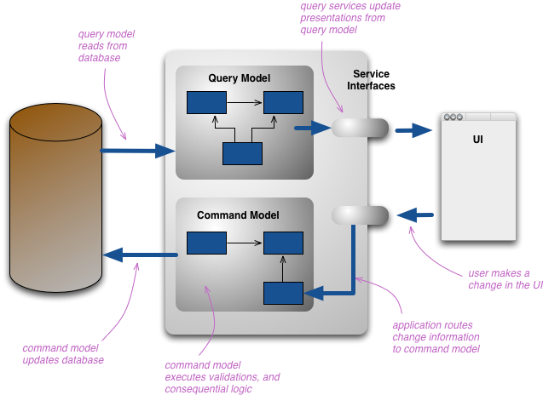
What is CQRS?
CQRS stands for Command Query Responsibility Segregation
Architecture level equivalent of Command Query Separation concept.
The pattern separates the commands and queries and allows us to scale them independently
Works on a assumption that in complex models, it is wise to break and conquer the domain logic

Slide 9
Demos

Slide 10
Advantages/Disadvantages of CQRS

Slide 11
Advantages
Allows us to scale read and write sides separately as required
Optimized schemas for the read and write sides
Queries become simpler as materialized views can be used to avoid complex joins/ cross query aggregation
Separation of read and write can lead to good maintainability

Slide 12
Disadvantages
Basic CQRS idea is deceptively simple, often the implementation becomes complex if not handled properly
When the read and writes are separated, it is necessary that any changes in the write side are synchronized to the read side which is generally accomplished with asynchronous messaging
Eventual consistency might not be correct for all applications

